Slide 1
OPTIMIZATION MINI PROJECT

Slide 2

PROJECT 8: EXAM SCHEDULING
Group members:
Bùi Minh Quang 20214925
Trịnh Thái Dương 20214954
Phạm Quang Tùng 20210919

Slide 3


Slide 4
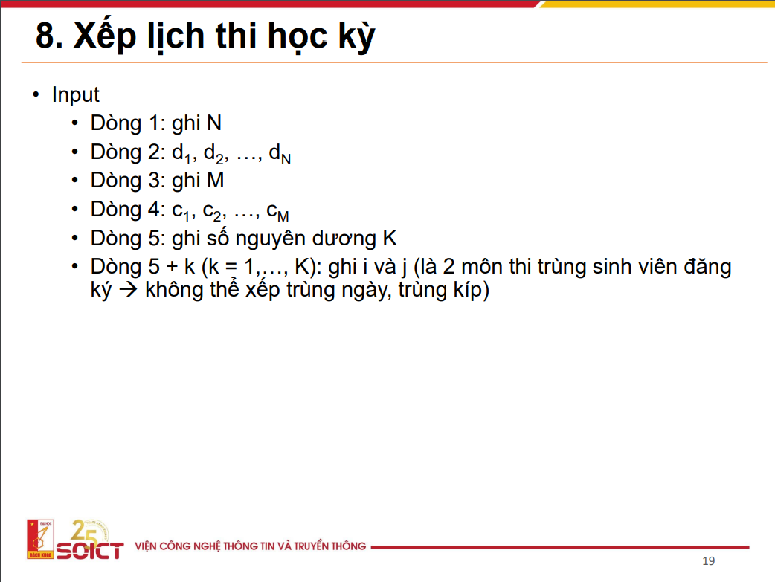

Slide 5
Test Case Generator
Small size with few constraints:
10 subjects, 2 rooms and 10 pairs
Small size with many constraints:
10 subjects, 2 rooms and 40 pairs
Medium size with few constraints:
50 subjects, 10 rooms and 50 pairs
Medium size with few constraints:
50 subjects, 10 rooms and 500 pairs
Large size with few constraints:
100 subjects, 20 rooms and 100 pairs
Large size with many constrains:
100 subjects, 20 rooms and 1000 pairs

Slide 6
I. CP-SAT
Create boolean variable
x(Boolvar): x[i][j][k]
i: subjects number ith
j: period number jth
k: room number kth

Slide 7


Slide 8
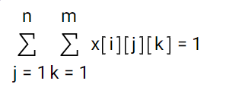
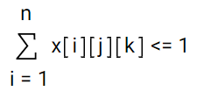
2. Create constraints
#1: for each room k, only can hold 1 subject
#2: for each period j, and room k, the subject i could be chosen to arrange or not

Slide 9
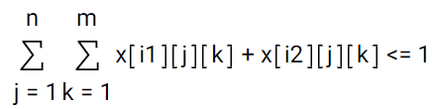
#3: number of subjects in previous period is more or equals to the number of subjects in current period
#4: for each pair of conflict subjects in conflict list:
#5: for each period j, we take P as the objective function that represent the total number of periods
P[j] = max(x[i][j][k])

Slide 10
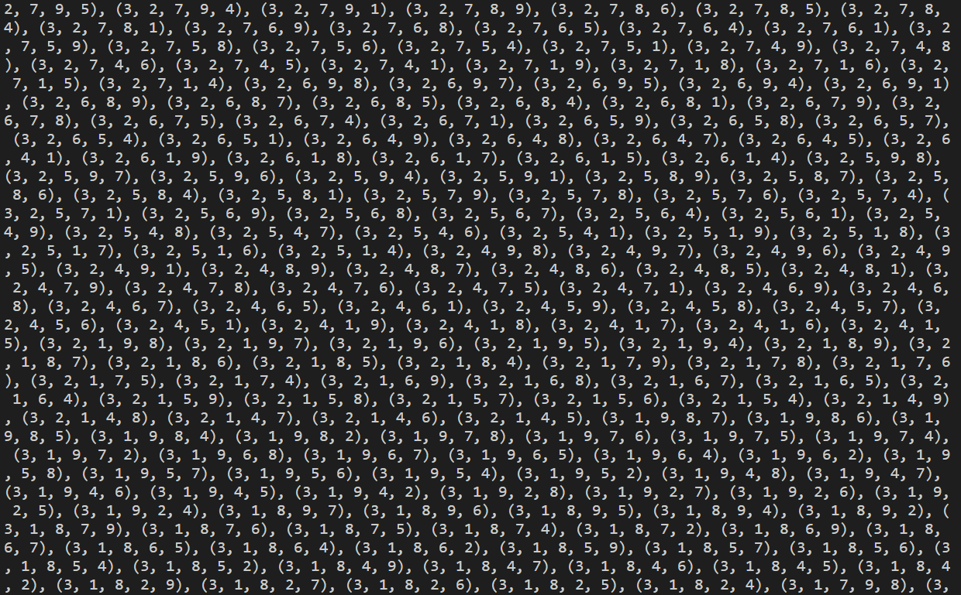
II. Bruteforce
Generate all possible ways to arrange for a period using permutation with the range from 1 to m (number of rooms)

Slide 11
2. Applying Greedy to take the most subjects arrangement
Constraint:
+ No pair of conflict subjects in a solution permutation
+ Number of students who take the subject i in a permutation > 0

Slide 12

Pros:
Only provides optimal solutions
Capable to runs large size input
Cons:
- Can not handle deep test cases or strict constraints
Pros:
Works well on strict constraints
Optimal for every inputs
Cons:

Slide 13
III. CP-Binary Implementation Idea
Set up all variables and constraints
p_checked = []
We set upper_bound = p, lower_bound = 0, then iteratively loop:
Ortools to check if this p contains any possible answers within 50 secs
if there is a solution for this p:
upper_bound = p
new_p = (upper_bound + lower_bound) //2
if there is NOT: lower_bound = p + 1
new_p = (upper_bound + lower_bound) //2
if there p is already in p_checked:
p_checked.append (p)
terminate
p = new_p
Return p_check[-1]

Slide 14
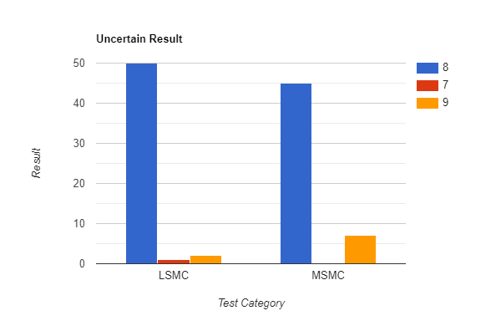
CP-Binary Advantage
Finds solutions within large size test in relatively low time (3 mins at max for largest test category LSMC, n = 100, m = 20, k = 1000)
Very easy to implement
The solution is optimal for 4 out of 6 categories (LSFC, MSFC, SSFC, SSMC)
The solution is 50% optimal, 50% uncertain but very close to near optimal solution (100% of uncertain answer is different at max 1 more timeslot used) for LSMC, MSMC test). In these test catergories, the algorithm gives the average anwser exceeding at 6% of optimal answer for LSMC and 4% for MSMC. (Avg Res: 9.33 for LSMC, 11.69 for MSMC)

Slide 15
Constraint Programming Disdvantage
Not always get the optimal solution
Increased number of constraints considerly increases time.
The accuracy may be affected by the consider number of conflict pairs
Limited test size compared to Greedy Method

Slide 16
IV. Greedy Algorithm Idea
Implementation Idea:
X[i][j][k] variable as the previous method
Sort all subjects by their scores.
Loop from 1 to n (maximum number of timeslot)
If subject does not conflict with any previous subjects:
loop for all available room:
if X[i][j][k] == 1:
assign this subject to this room
remove this room from available room in this timeslot
If there is no subject left:
terminate and return current k as the timeslot needed
For the optimality of the answer, the order of input subjects is important
We assign each subject a score computed by their relative number of attendants and number of conflicted pairs they are in, then we sort the subjects in this order

Slide 17
Greedy Algorithm Improvement Idea
It is easy to recognize the importance of order of subject to put in.
To make this algorithm more robust to any skewed input:
Scaling all the subject attendants down to range of [0,1]
Scaling all the subject degree in conflicted pairs down to range of [0,1]
A total score for subject is calculated as follow: score[i] = attendant_score[i] + conflict_score[i]
Sorting subjects by their score order

Slide 18
Greedy Algorithm Implementation Idea
A list of ordered remaining subject is created: remain_sub = []
p = 0
For time in range(n):
p += 1
subject_registed = []
available_room = []
for sub in remain_sub:
if this sub conflict with any sub in subject_registed:
continue
for j in available_room:
if this room capacity > number of attendents of this subject:
organize at this room, timeslot
remove this room from available_room
remove this subject from remain_sub
if remain_sub is empty:
end

Slide 19
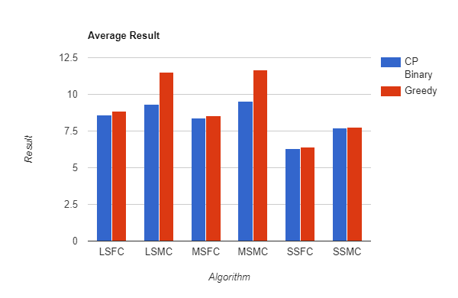
Greedy Algorithm Advantage
Really fast computation time. Run up to 2000 subjects, 50 classes, 10000 pairs in less than a minute
Quite high optimality. Only exceed near optimal answer at 2% for small test (both many and few constraints) medium size test and large size test with few contraints,
23% at MSMC and LSMC.

Slide 20
Greedy Algorithm Disadvantage
Cannot get the optimal answer
The method of getting score can be improved by taking into consideration of complexity of conflicts then assigning different weight to capacity and conflicts factor. In other word, this parameter can be tuned

Slide 21
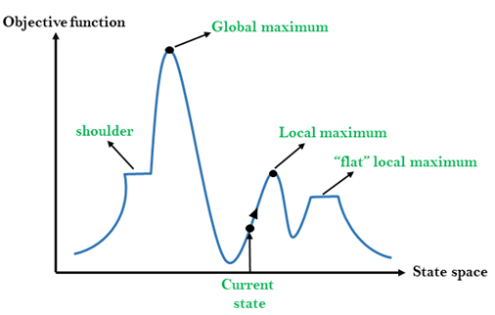
STOCHASTIC HILL CLIMBING SEARCH
Evaluate the initial state. If it is a goal state then stop and return success. Otherwise, make the initial state the current state.
Repeat these steps until a solution is found or the current state does not change.
Select a state that has not been yet applied to the current state.
Apply the successor function to the current state and generate all the neighbor states.
Among the generated neighbor states which are better than the current state choose a state randomly.
If the chosen state is the goal state, then return success, else make it the current state and repeat step 2 of the second point.
Exit from the function.

Slide 22
V. STOCHASTIC HILL CLIMBING SEARCH IDEA
First, we generate a random schedule and assume this schedule as current state and assign min_periods_num as the number of periods of this schedule.
Then, we generate a random neighbour of current state by some methods:
Change the rooms of period of current schedule.
Select two random periods in current schedule and check whether this two random periods can be combined or not. If they can be combined, combine that two periods.
We check whether the new schedule is better than the current schedule or not. If the new one is better, we assign the current one as the new one and the assign min_periods_num as the number of periods of this schedule.
We repeat this process 10,000 times and return the final schedule.

Slide 23
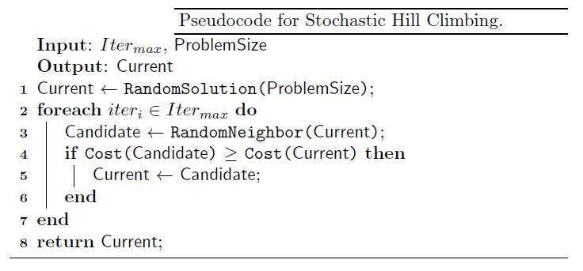
STOCHASTIC HILL CLIMBING SEARCH PSEUDOCODE

Slide 24

STOCHASTIC HILL CLIMBING

Slide 25
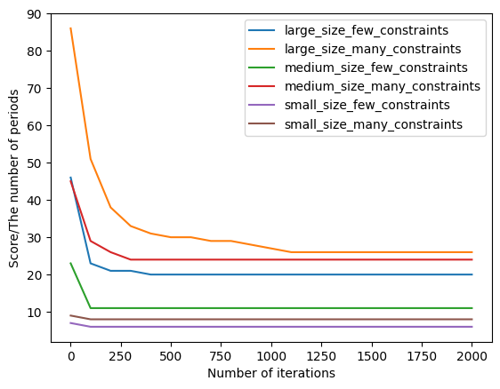
VISUALIZATION

Slide 26
Pros and Cons
Pros:
Running time is low with small test case and few constraints.
Simple algorithm.
Cons:
Not always give the optimal solution.
Running time is high with large test case and many constraints.

Slide 27
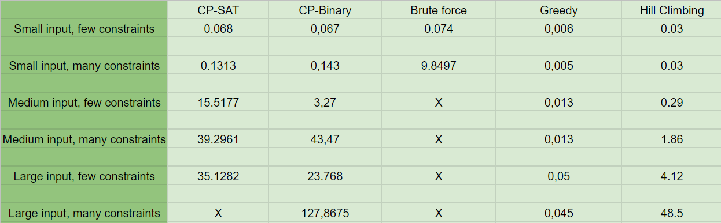
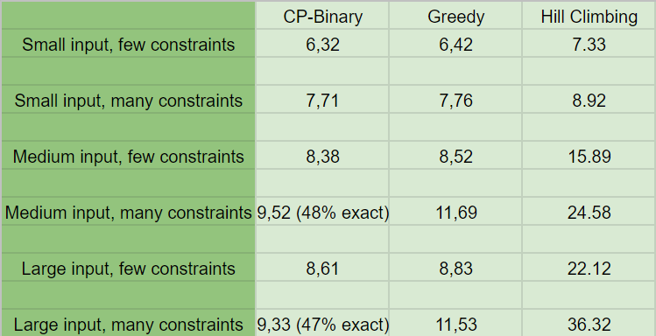
VI. Time and result check
I. Time comparison
II. Result comparison

Slide 28
THANK YOU !

